Slide 1
AI in Industry - Loss Function Optimization for Clipping Function in the SMLE

Slide 2
Core - Problem
The SMLE framework utilizes clipping functions to bound it’s estimates
Focus Here: the clipping functions
Only Regression
Goal: Optimize the Clipping Box for the SMLE
Currently, the MSE is used
Three main Questions:
Can the Loss function be improved in General?
Is there a Regularization type / Loss function dominating all others?
Are there important takeaways, guidelines for future applications?

Slide 3
Approach
Reduction of the model to just the clipping functions
Initial Selection of loss function and regularization
Mean Absolute Error (MAE)
Lasso regularization
Ridge regularization
Elastic Net
L0 regularization in combination with ridge regularization
Use different parameter values to see the behaviour
Can the penalization parameter be updated through Gradient Descent as well?

Slide 4
No Regularization
The MSE is already very good
MAE has slight improvements in all modelling results
MAE requires longer training time
If training time is negligible → performance improvement

Slide 5
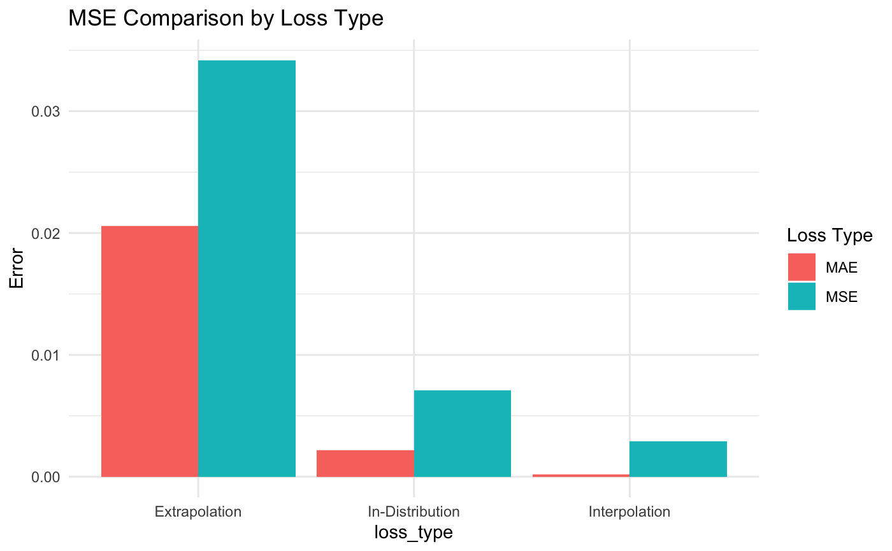
No Regularization – Mean Square Error

Slide 6
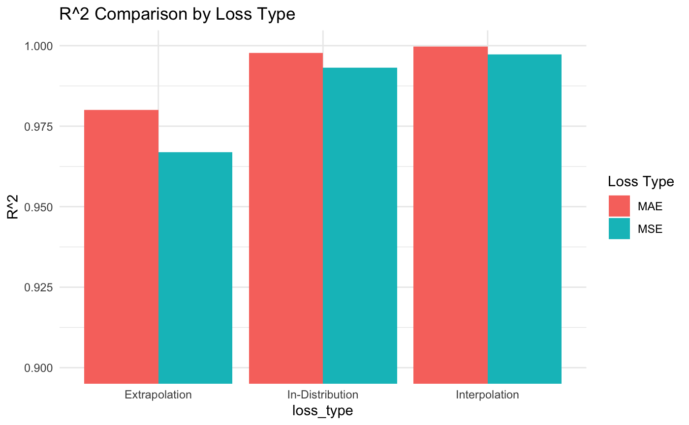
No Regularization – R²

Slide 7
Lasso Regularization
MSE Base Loss
Pseudo Hill climbing approach
Lambda values analyzed within the range (0.01 ; 0.0005)
Lambda = 0.01 → Worse than the optimum constant (arithmetic mean)
Best Lambda values around 0.00011
In statistics: considered to be very small / weak regularization
Only partial & weak improvements could be observed

Slide 8
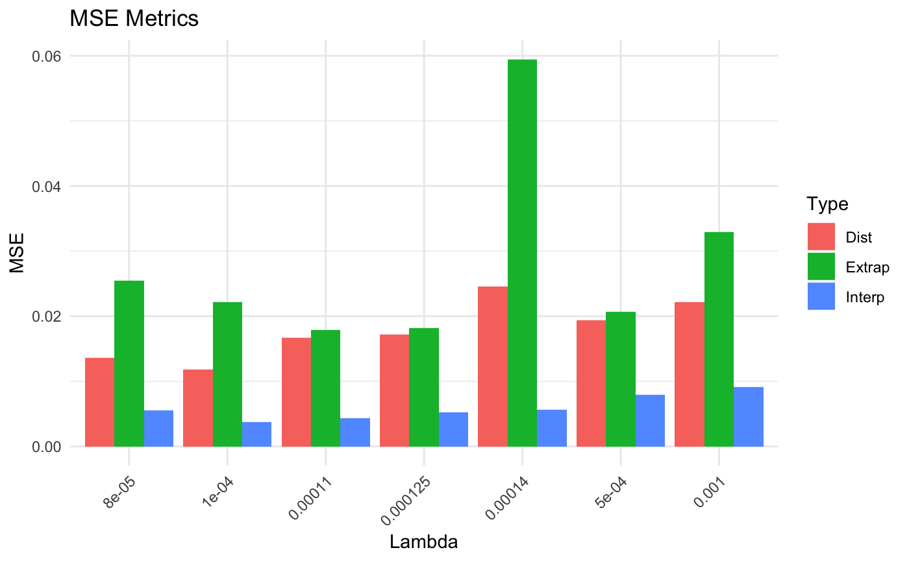
Lasso Graphics – Mean Square Error

Slide 9
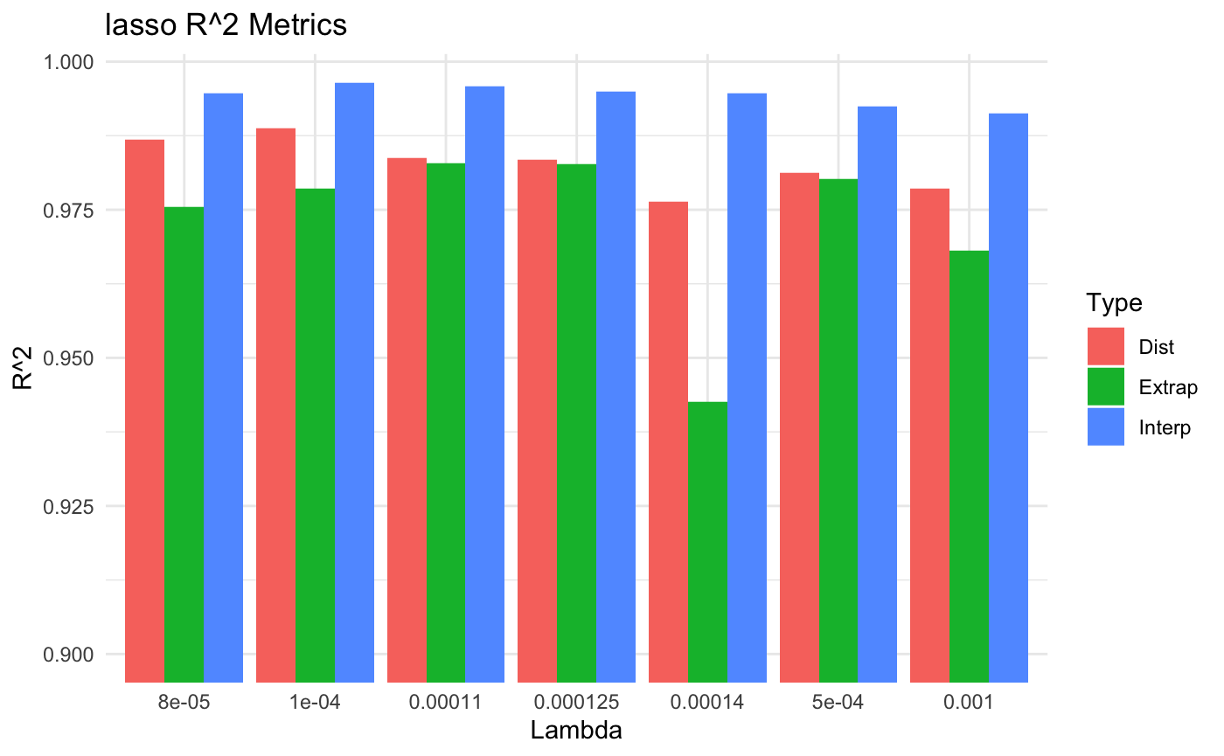
Lasso Graphics – R²

Slide 10
Ridge Regularization
MSE Base Loss
Pseudo Hill climbing approach
Lambda values analyzed within the range (0.02 ; 0.00010)
More robust than Lasso
Best Lambda values around 0.0007
Weak regularization
Partial and weak improvements for Interpolation & Extrapolation compared to the MSE

Slide 11
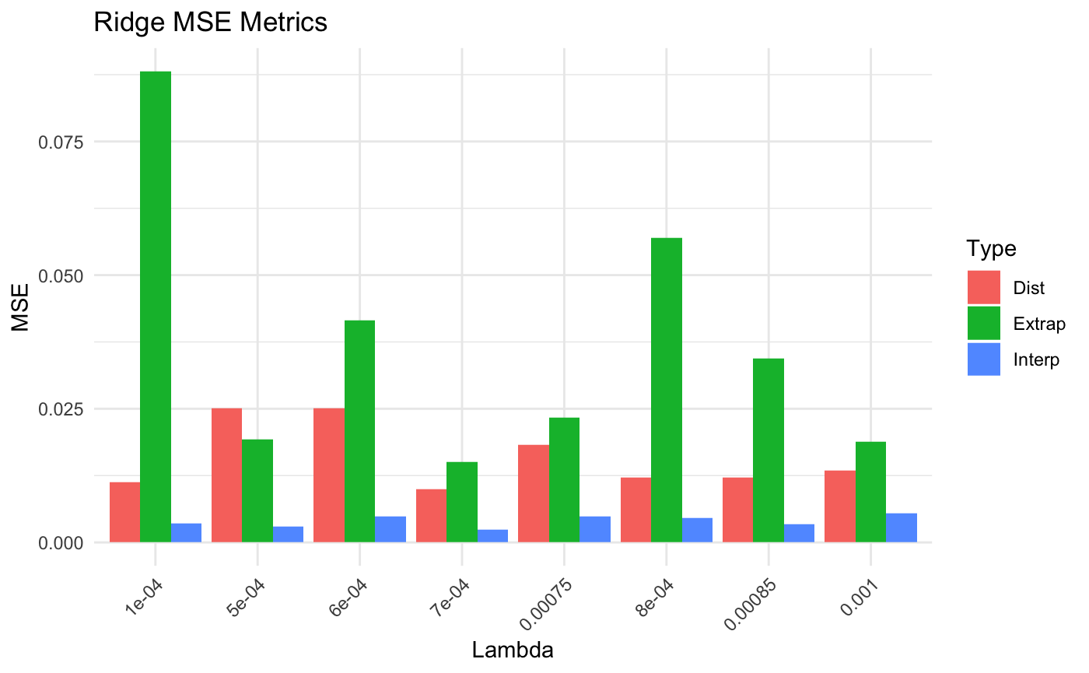
Ridge Graphics – Mean Square Error

Slide 12
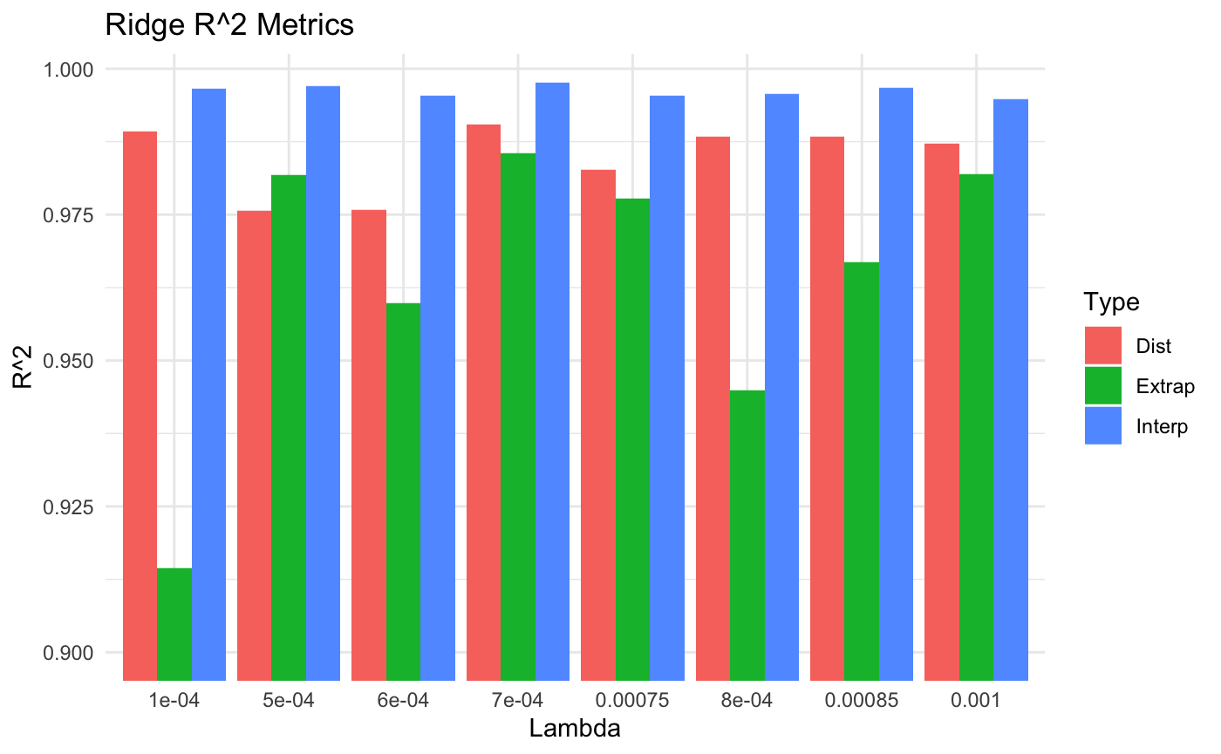
Ridge Graphics – Mean Square Error

Slide 13
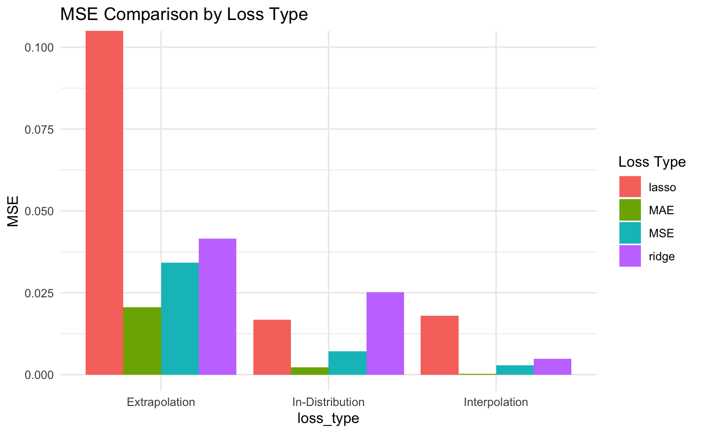
Comparison 1 – Mean Square Error

Slide 14
Dynamic Regularization
Hyperparameter Optimization via Gradient Descent
For both Lasso and Ridge starting values
Can this approach be used for fine-tuning or starting point for researchers?
Unfortunately, the model wasn’t able to actually optimize Lambda through Gradient Descent

Slide 15
Dynamic Regularization
Regularization | Lambda Start | Lambda End
Lasso | 0.00011 | 0.000110000000859
Lasso | 0.01 | 0.009999999776482
Lasso | 0.005 | 0.004999999888241
Ridge | 0.0008 | 0.000799999979790
Ridge | 0.1 | 0.100000001490116
Ridge | 0.05 | 0.050000000745058

Slide 16
Elastic Net
MSE Base Lose
Shared Lambda value, high alpha → lasso, low alpha → ridge
Heat map analysis
Somewhat Unstable
Lamba within the range (0.001;0.0001)
Alpha values for (0.9, 0.75, 0.5, 0.25, 0.1)
Weaker penalization generally better performance
Better performance if it’s weighted towards either Ridge or Lasso Regularization
Weak improvements achieved over MSE

Slide 17
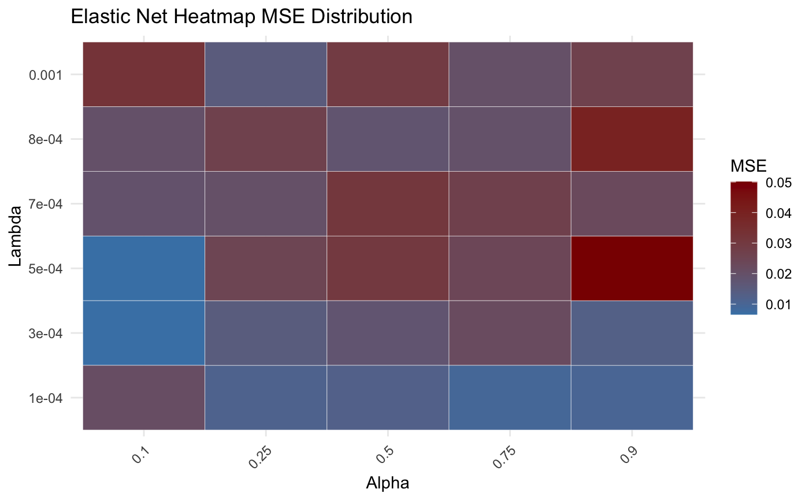
Elastic Net – Distribution Mean Square Error

Slide 18
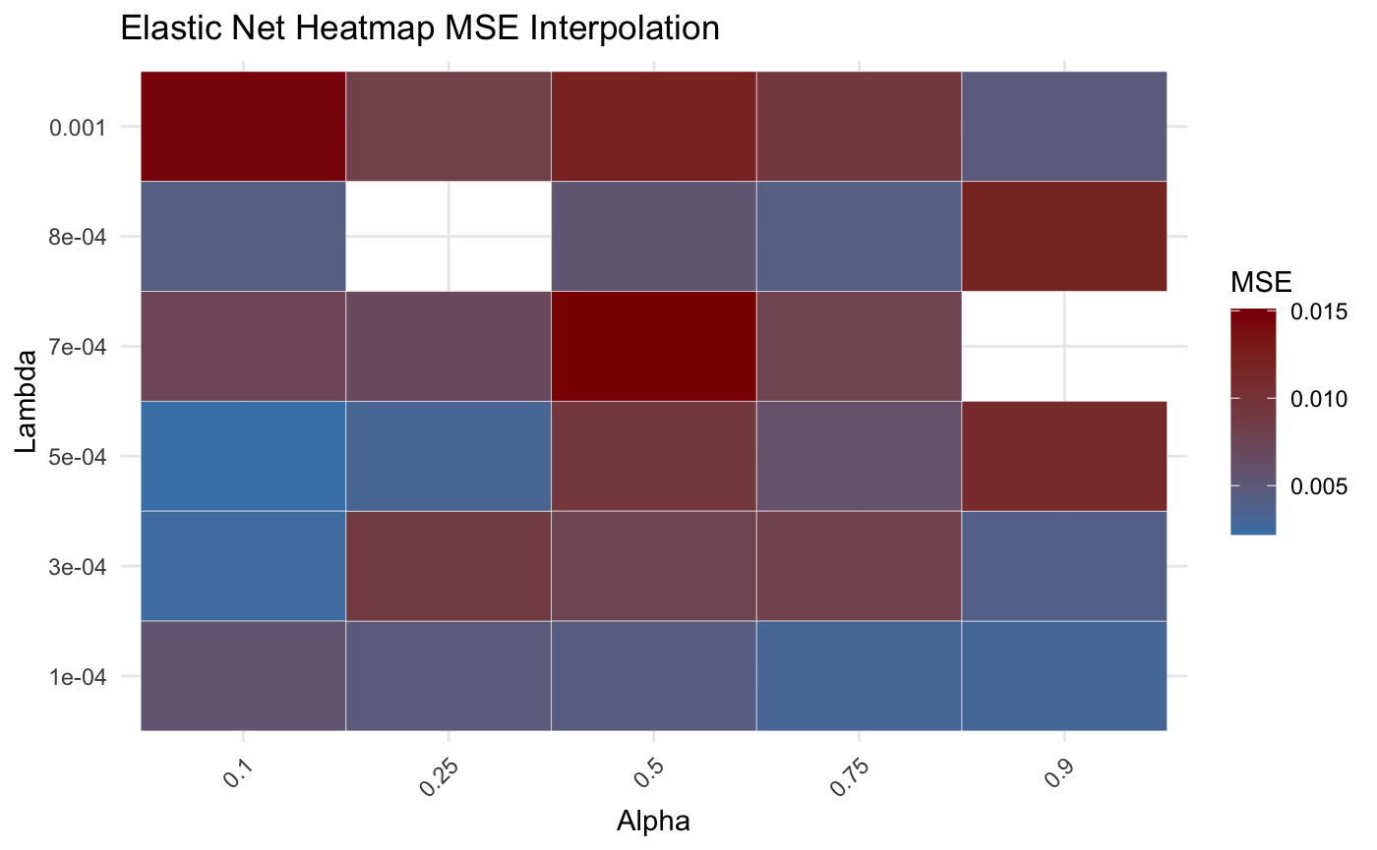
Elastic Net – Interpolation Mean Square Error

Slide 19
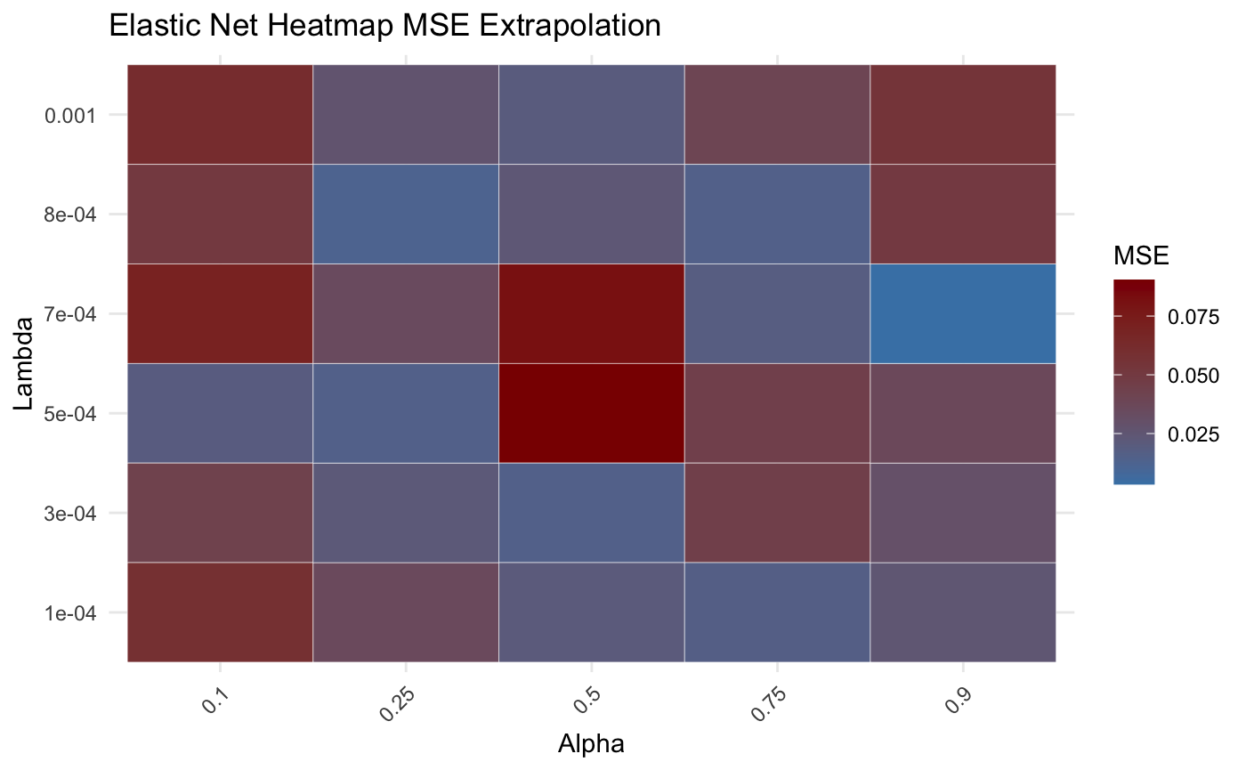
Elastic Net – Extrapolation Mean Square Error

Slide 20
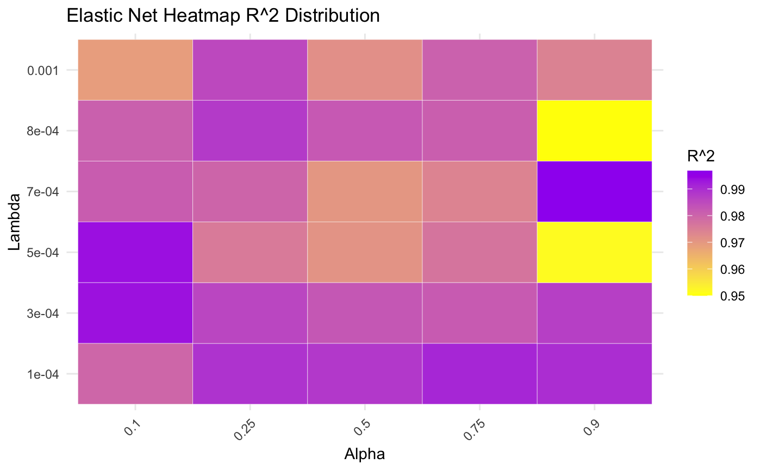
Elastic Net – Distribution R²

Slide 21
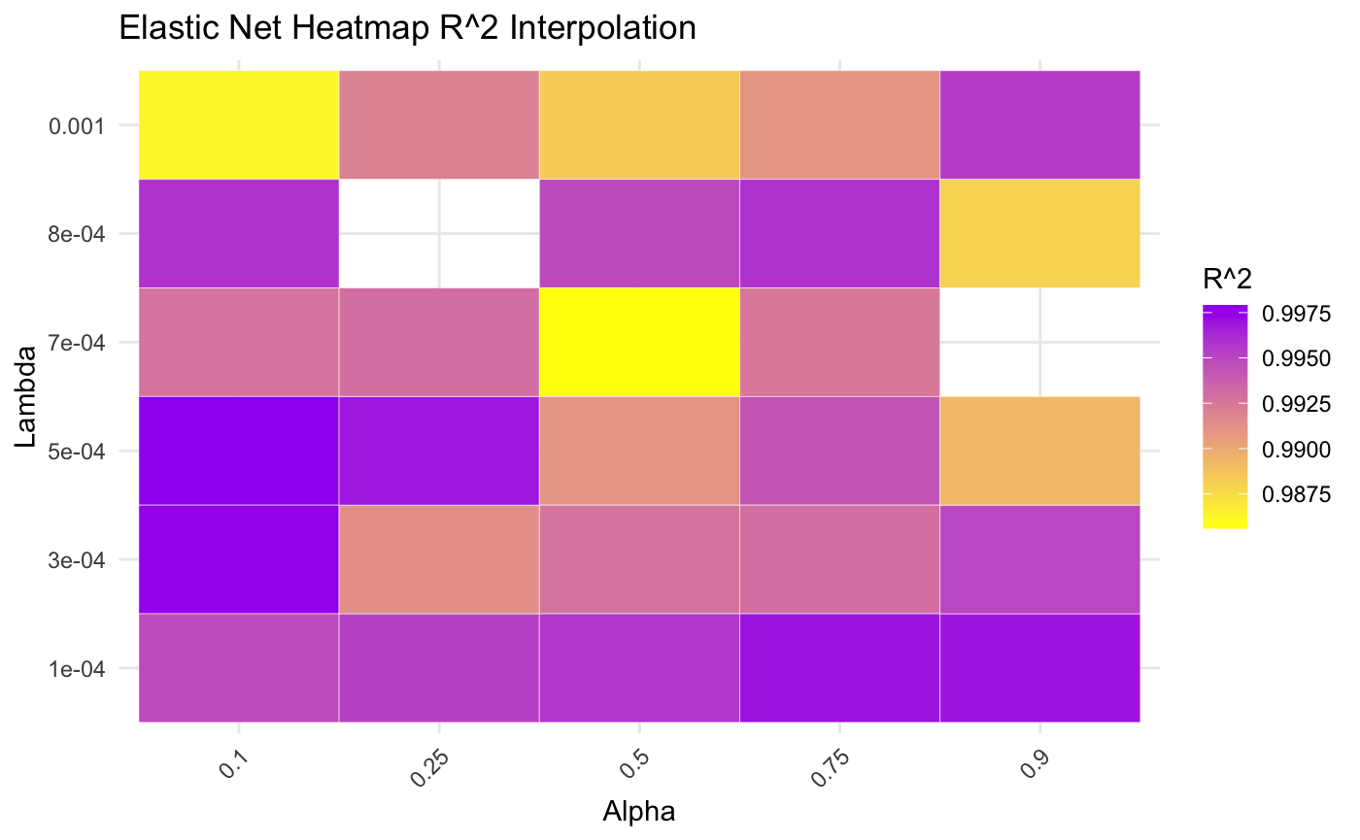
Elastic Net – Interpolation R²

Slide 22
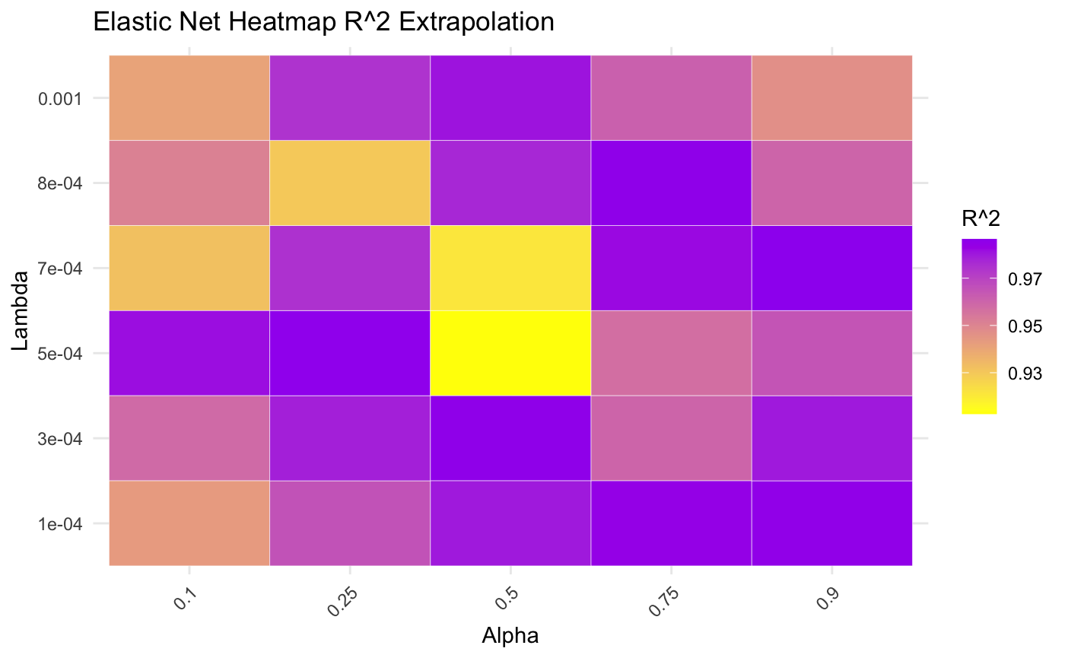
Elastic Net – Extrapolation R²

Slide 23
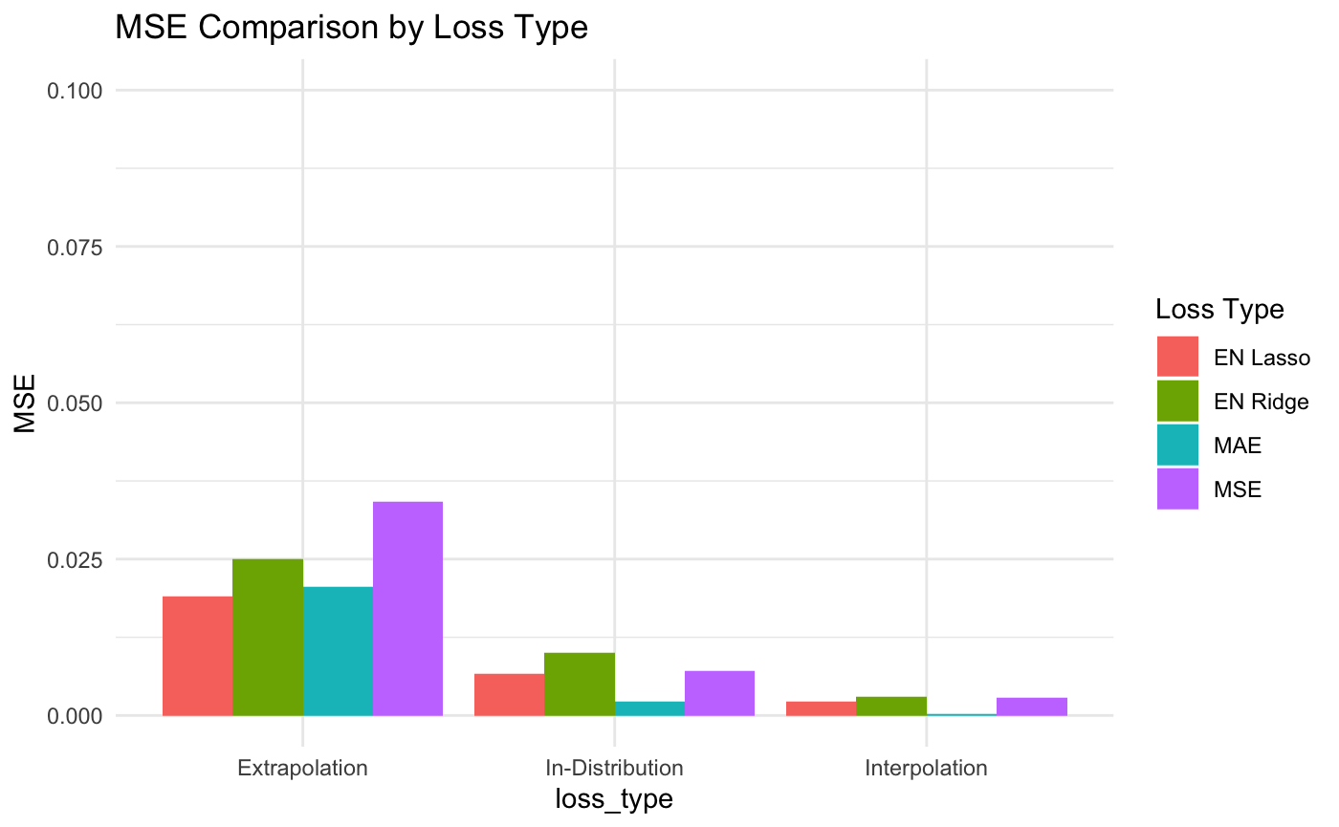
Comparison 2 – Mean Square Error

Slide 24
L0 & Ridge - Regularization
L0 - Regularization - penalizes non zero parameters
Alternative approach to dropping parameters / weights
Hard to optimize
Is this plausible way to deal large number of parameters / weights?
Lambda = 0.0008, l0-pen (0.1, 1, 5, 10, 20, 100, 200, 500)
Best for around l0-pen = 10
Robust for large l0-penalization
Performs better for extrapolation, worse than distribution than MSE

Slide 25
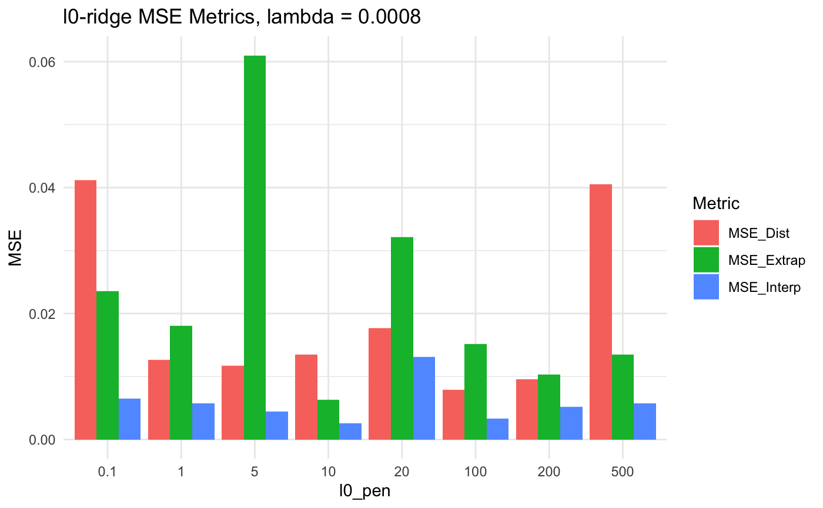
L0-Ridge Graphics

Slide 26
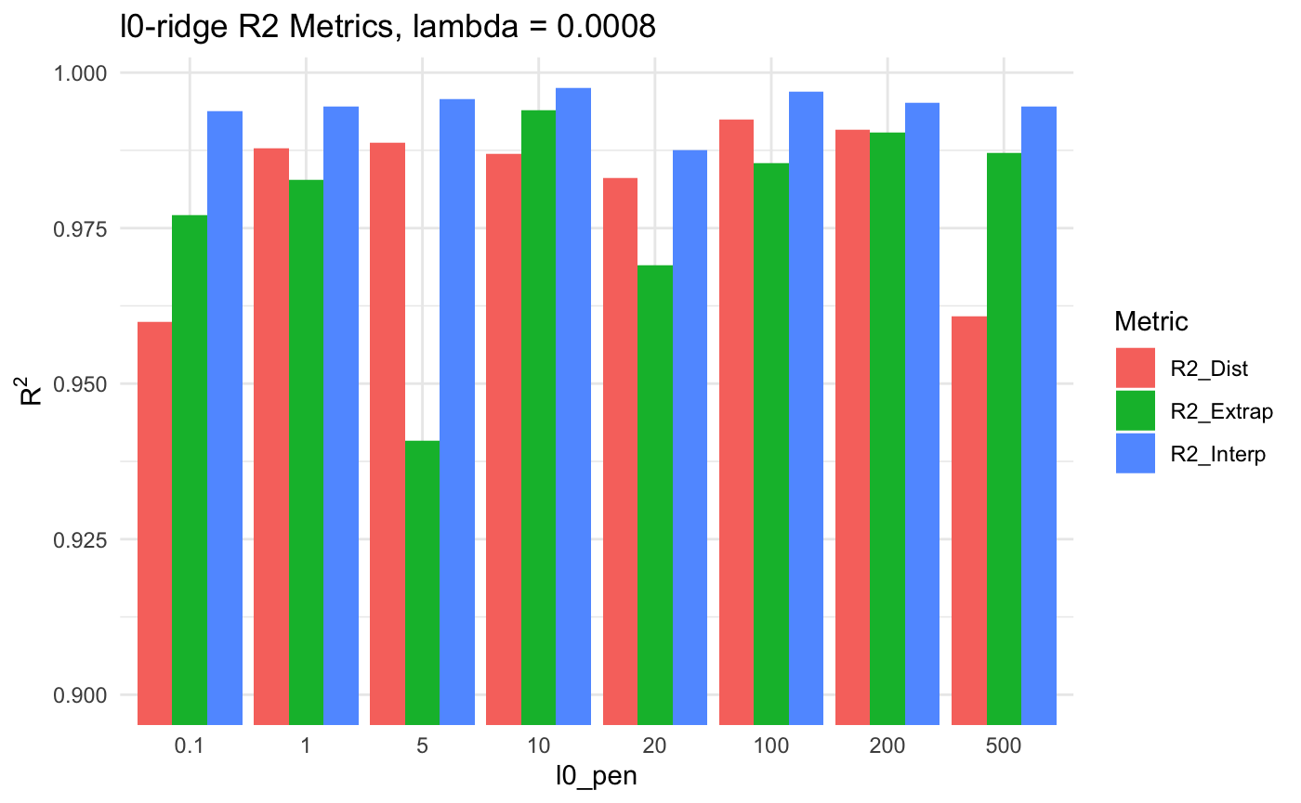
L0-Ridge Graphics

Slide 27
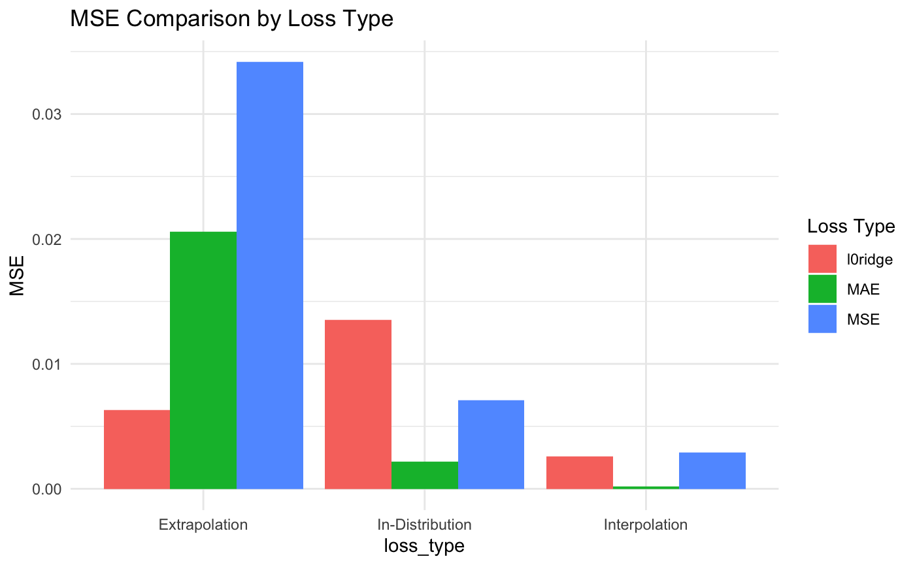
Comparison 3 – Mean Square Error

Slide 28
Results
Can the Loss function be improved in General?
Yes! Multiple approaches can result in improvement!
Is there a Regularization type / Loss function dominating all others?
Somewhat. The MAE performs best for Distribution & Interpolation
For Extrapolation, the more complicated regularization approaches can achieve better performance
Are there important takeaways, guidelines for future applications?
The MAE should be considered
Weak regularization best for Ridge & Lambda
The Elastic Net is best when it isn’t balanced
L0 & ridge combined Regularization can be a useful approach to deal with high variable / parameter counts

